Slide 1
Arcade Simulation with FPGA Boards
NICK BUREK AND THOMAS GRIEBEL
LORAS COLLEGE

Slide 2
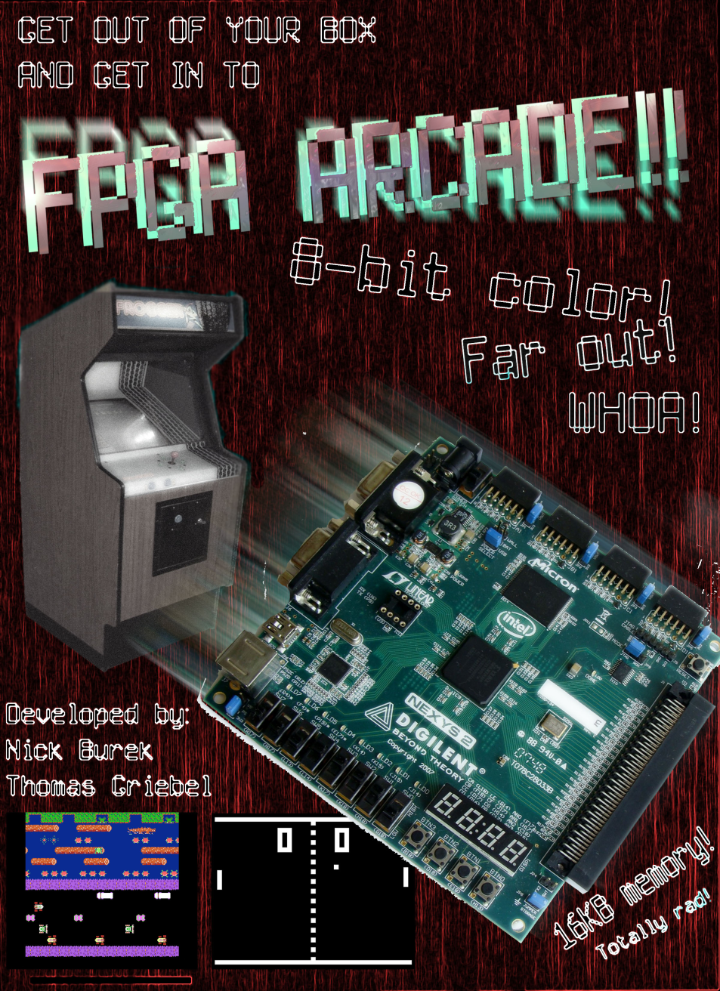
FPGArcade

Slide 3
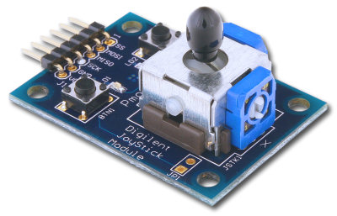
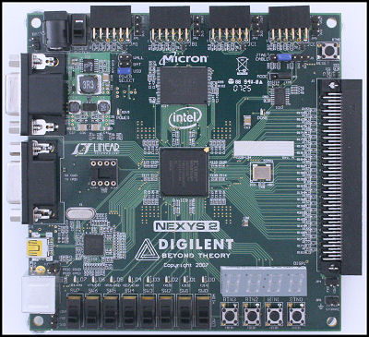
Hardware

Slide 4
Project Overview
Joystick Module
VGA Driver
  Video RAM
Microblaze Microprocessor Core
  Interface Libraries
  Game Code

Slide 5

Joystick Module
Serial Peripheral Interface (SPI)
5 bytes
  2 for X
  2 for Y
  1 for buttons

Slide 6
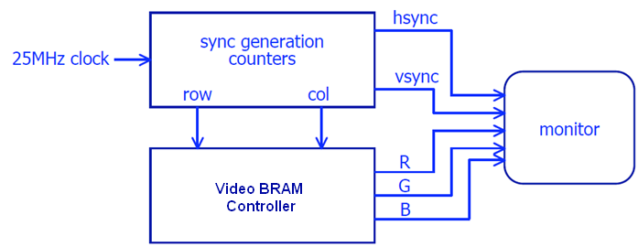
VGA Driver
Overview
  25 MHz clock
  Horizontal and Vertical Sync signals
  8 bit color
Video BRAM
  Tile Based Graphics System

Slide 7
Tile Based Graphics
Why?
  307,200 Bytes – if storing every pixel
  Requires use of Micron RAM
    Timing concerns
  7,876 Bytes – if using a tile based system
How it works
  Inspired by the NES PPU
  Screen is divided 80x60 grid
  Storage for 64 8x8 tiles
  Repetition of tiles dramatically reduces file size

Slide 8
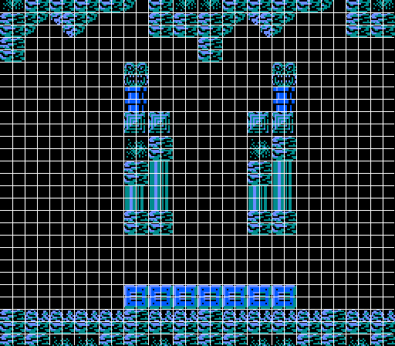
Tile Based Example

Slide 9
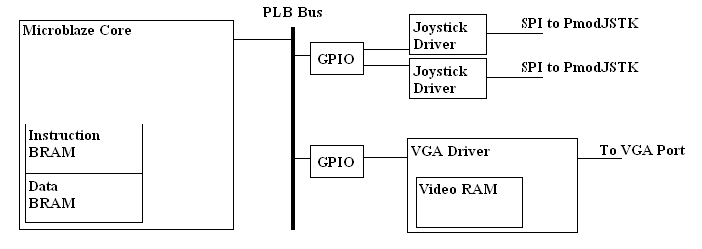
Adding Microblaze to the System
16KB of Instruction space and Data space
Memory Mapped I/O through GPIO blocks
  Allows for interface with Joystick Modules and VGA Driver

Slide 10
Software Hardware Interface Libraries
Joystick Library
  Functions to retrieve joystick data
Graphics Library
  Used for outputting data to the Video RAM
  Abstracts away the 32-bit instruction set needed for communication
  Transform graphic data stored using our convention

Slide 11
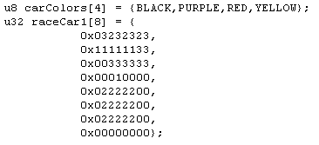
Graphic Data Convention
Use an array of type U32 to store indexed colors
Each U32 variable stores 8 pixels (1 row)
  4 bit indexed color
Each array stores 8 U32’s in order
Example:

Slide 12
Demo

